Slide 1
Interfacing 16×2 LCD with Raspberry Pi
BY-
IFTEKAR ANSARI-B445
SUNIL GAIKAWAD-B446
ABHAY PAROCHA –B452
SHIVAM YADAV- B455

Slide 2
ABSTRACT
In this project, you can see all the steps for Interfacing a 16×2 LCD with Raspberry Pi like circuit diagram, components, working, Python Program and explanation of the code. Even though the Raspberry Pi computer is capable of doing many tasks, it doesn’t have a display for implementing it in simple projects. A 16×2 Alphanumeric Character LCD Display is a very important types of display for displaying some basic and vital information.

Slide 3
INTRODUCTION
lcd display plays a vital role in any project, it helps in displaying the values of many sensors and other stuffs too. But in this project ,we had used raspberry pi to interface with the 16*2 lcd display using python language to get the desired output.

Slide 4
COMPONENTS
Raspberry Pi 3 Model B (any Raspberry Pi)
16 x 2 LCD Module
10 KΩ Potentiometer
Mini Breadboard
Connecting wires (Jumper wires)
5V – 2A Power Supply
Miscellaneous (Computer, Ethernet Cable, etc.

Slide 5
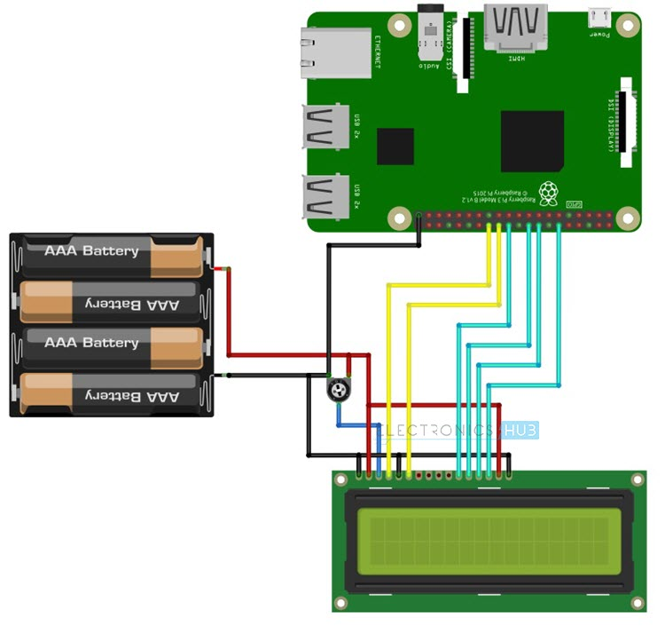
CIRCUIT DIAGRAM

Slide 6
WORKING
The working of project for Interfacing 16×2 LCD with Raspberry Pi is very simple. After making the connections as per the circuit diagram, login to your Raspberry Pi using SSH Client like Putty in Windows.
Alternatively, you can use software like Proteus. (NOTE: I’ve used Proteus Software for accessing the Simulation of Raspberry Pi’s Desktop on my personal computer). I’ve created a folder named “lcd_rpi” on the desktop of the Raspberry Pi. So, I’ll be saving my Python Program for Interfacing 16 x 2 LCD with Raspberry Pi in this folder.
Using “cd” commands in the terminal, change to this directory. After that, open an empty Python file with name “lcdPi.py” using the following command in the terminal. Now, copy the above code and paste it in the editor. It is important to properly use the Tab characters as they help in grouping the instructions in Python.

Slide 7
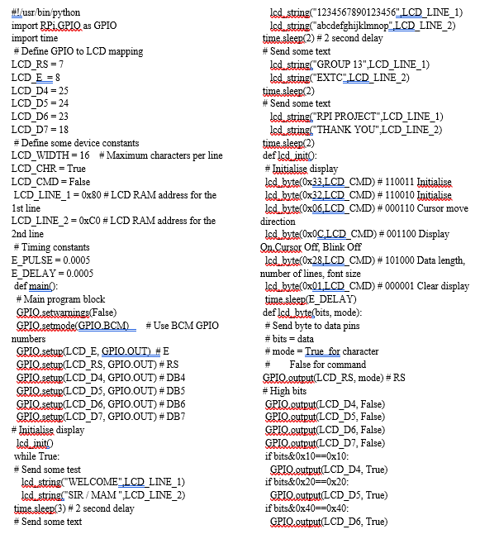
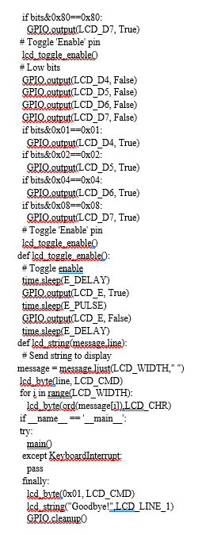
code

Slide 8
LIMITATIONS
The 16×2 LCD Module can only display simple alphanumeric characters.
Even though some special characters and custom characters can be displayed, information which is graphic intensive cannot be displayed.

Slide 9
APPLICATION
By interfacing 16×2 LCD with Raspberry Pi, we can have a simple display option for our raspberry Pi which can display some basic information like Date, Time, Status of a GPIO Pin, etc.
Many simple and complex application of Raspberry Pi like weather station, temperature control, robotic vehicles, etc. needs this small 16×2 LCD Display.

Slide 10
thankyou

